Slide 1
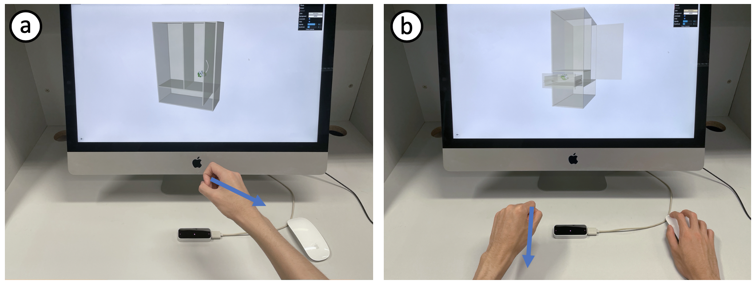
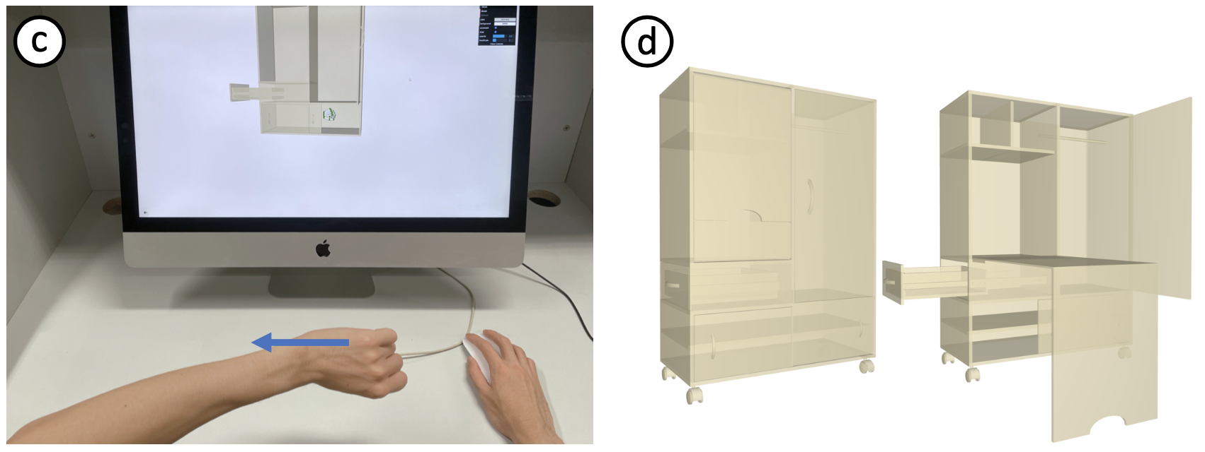
A Motion-guided Interface for
Modeling 3D Multi-functional Furniture
Minchan Chen and Manfred Lau
Notes:
I’m Minchan from City University of Hong Kong.
Today I am going to introduce our paper: A motion-guided interface for modeling 3D multi-functional furniture.

Slide 2
3D Modelling Tools
Notes:
3D modelling plays a significant role in design and fabrication.
While commercial modeling software is too complex and difficult for novices (click)

Slide 3
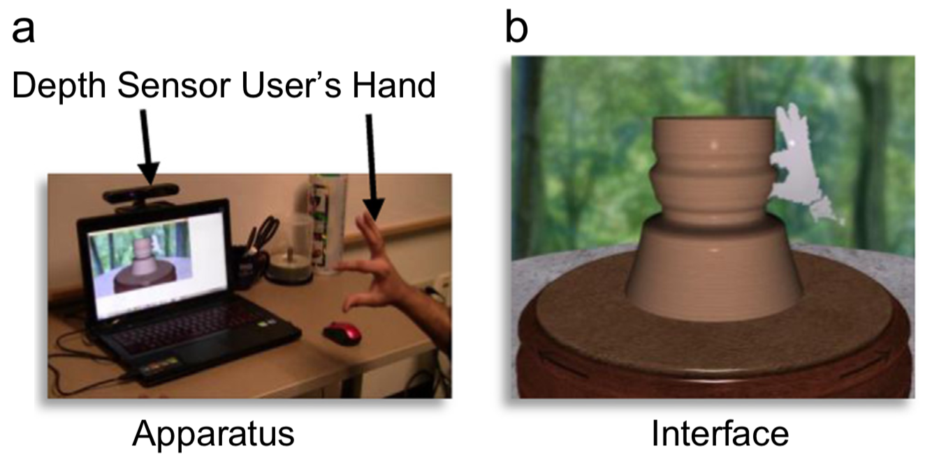
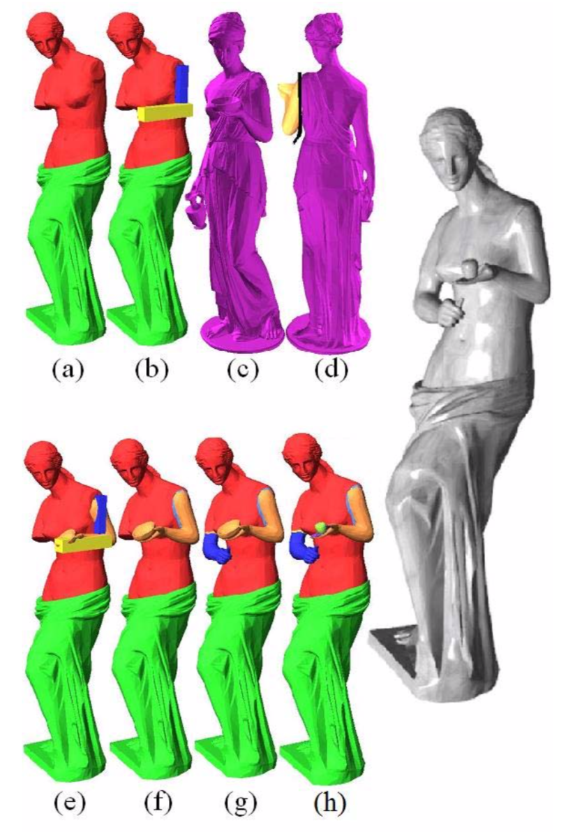
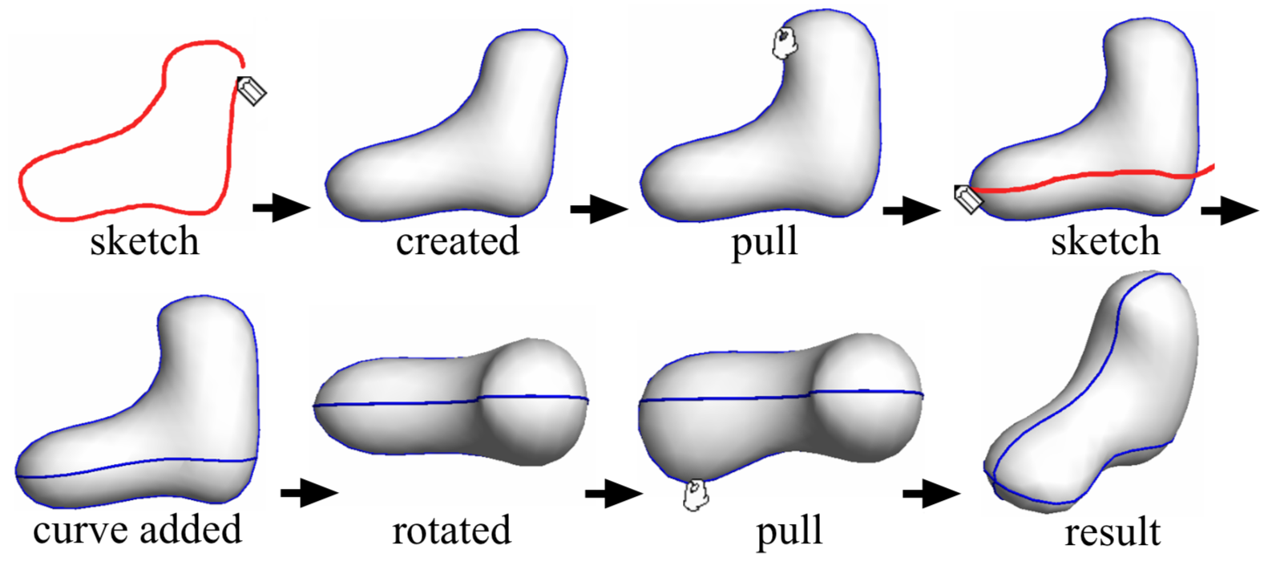
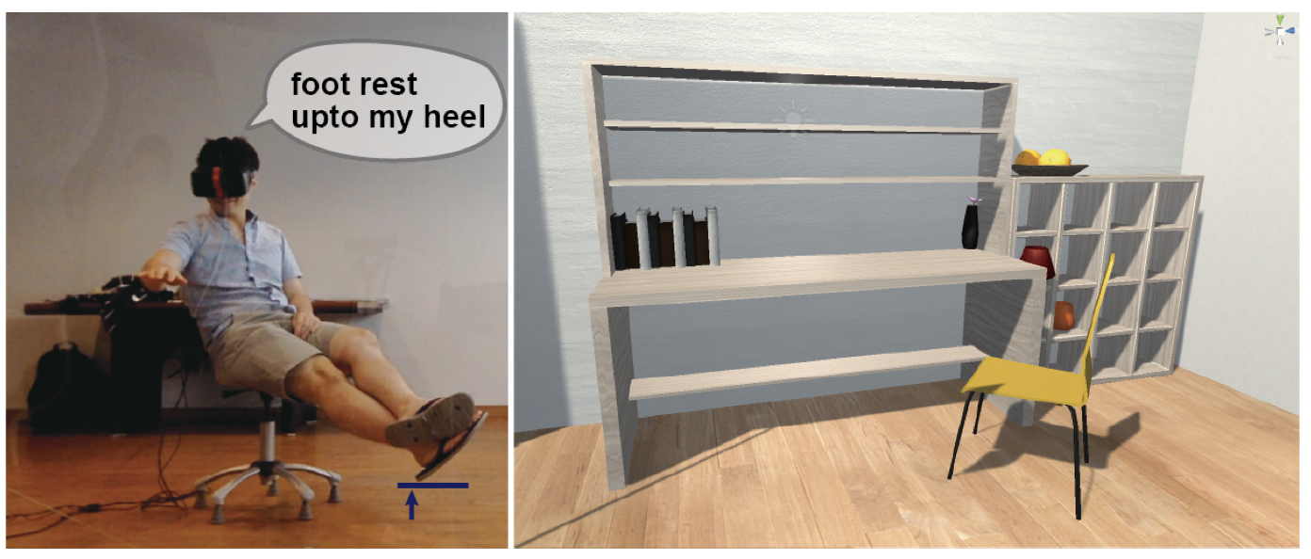
3D Modelling Tools
deformation
composition
sketching
[Ramani et al. 16]
interactive indication
[Nealen et al. 07]
[Funkhouser et al. 04]
[Lee et al. 16]
Notes:
researchers proposed various modeling tools such as
(click) sketching,
(click) part segmentation and re-composition,
(click) shape deformation,
(click) or interactive indication.

Slide 4
Our goal
Multi-poses object
Static object
[Lee et al. 16]
Notes:
However, most of those works focused on modeling static objects (which remain still during user interaction)
(click) and ignored dynamic objects (which have multiple poses during user interaction).
Here is an example of a multi-functional cabinet that expands from its compressed state.

Slide 5
Our goal
Multi-poses object
A modeling system for conceptual design of multi-functional furniture
Notes:
Therefore, we aim to propose a 3D modeling system for the conceptual design of multi-poses object. More specifically, we focus on the modeling of multi-functional furniture, which is a typical multi-poses object and is related to people’s life closely.

Slide 6
Key idea
A “motion-guided” interface
Notes:
The key idea of our modeling interface is that we follow a “motion-guided” concept, which means, in order to create furniture with the dynamic components,
(click) users should perform 3D modeling operations as if they are interacting with them.
For example, rotate the cabinet to create wheels, pull outward to create doors or pull out to create a drawer.

Slide 7
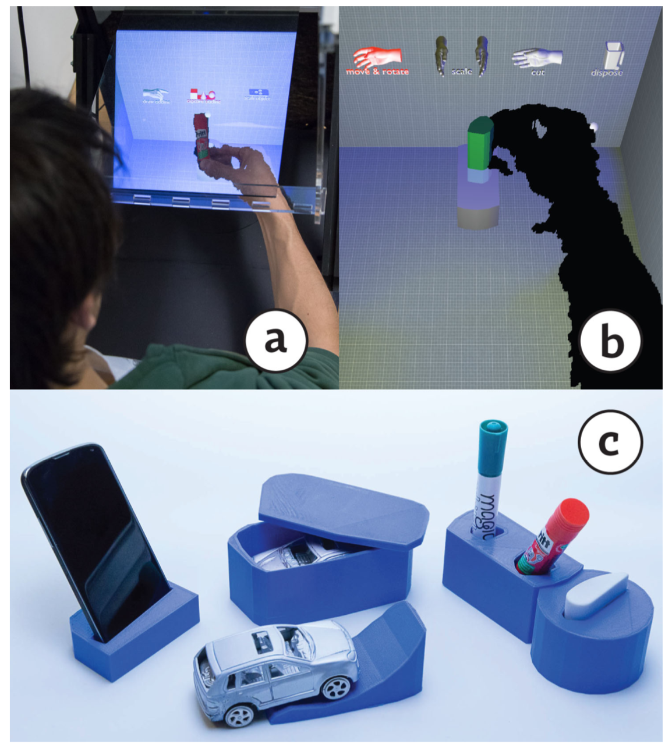
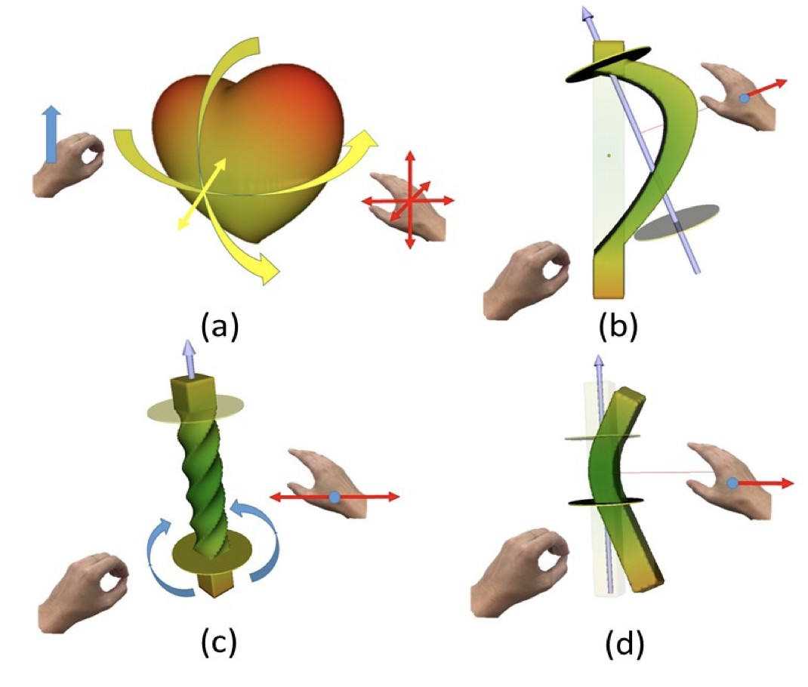
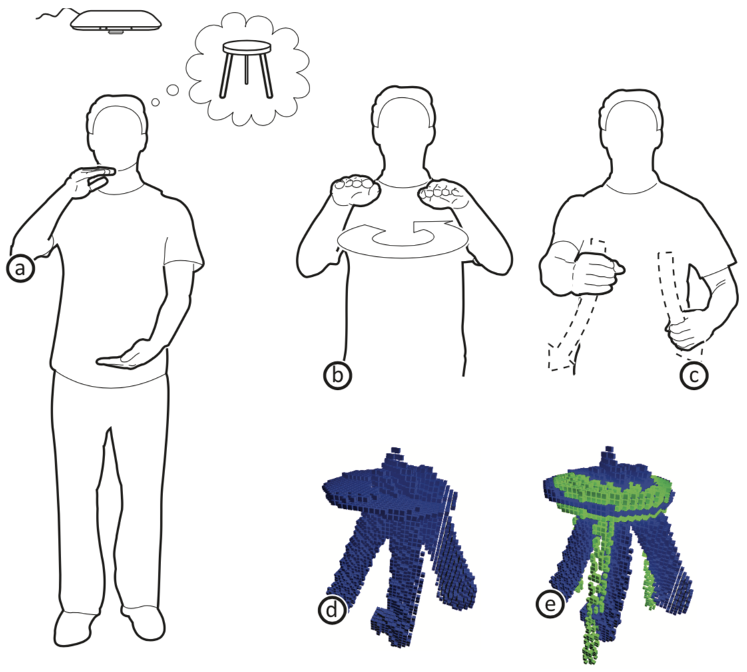
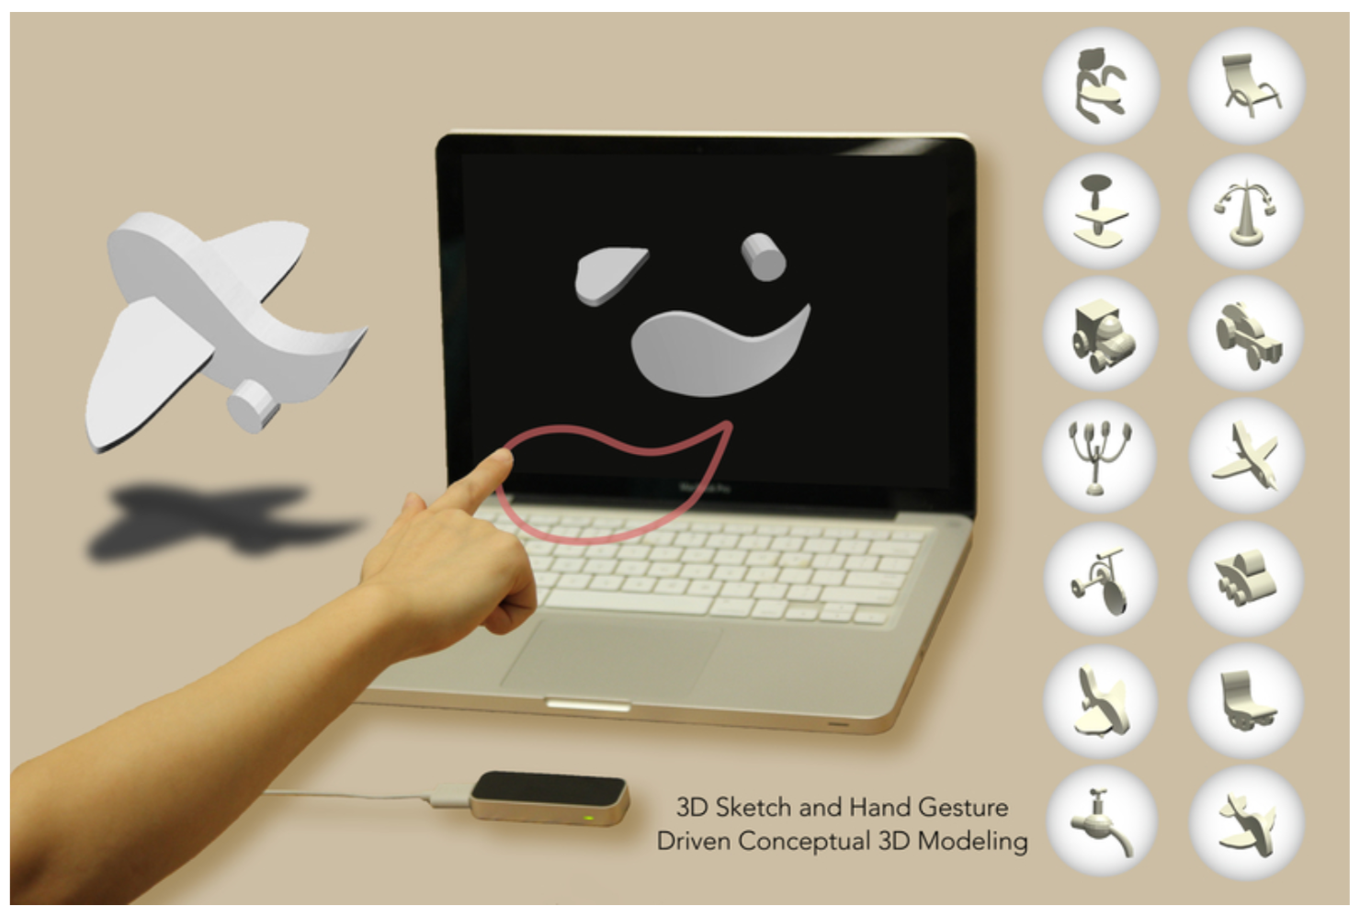
Related works
[Zhang et al. 13]
[Lee et al. 18]
[Weichel et al. 14]
[Cui et al. 17]
[Holz et al.11]
[Huang et al. 18]
Notes:
Previous works also involved the motion-guided concept or apply user’s interaction into 3D modeling
(click) Some used body motions to make avatar modifications
(click) and other used body interaction to create static table.
However, none of them explore how users can naturally interact with the dynamic component.
Besides, hands are widely used in 3D modeling.
(click) Some work used hands to replace CAD operations in immersive environments,
(click) or used hands to do geometric deformations
(click) or depicted object directly.
Although those mentioned works utilized hands in various ways, none of them studied how people can use hands to describe multi-pose components

Slide 8
Pipeline
Preliminary user study
System Implementation
Evaluation user study
Notes:
To achieve our goal, we follow a user-oriented approach.
(click) First, we conducted a preliminary user study to explore the users’ preferred hand motions for creating various furniture components.
(click) Then we implemented a 3D modeling system with the elicited gestures as a basis for the motion-guided user interface.
(click) Finally, we conducted an evaluation user study to demonstrate that our user interface is user-friendly and useful for novices to perform conceptual furniture design.

Slide 9
Preliminary user study
Task 1: dynamic component
Notes:
Our preliminary user study consists of 3 parts
(click) First, participants were shown videos with an unfinished cabinet or table, and then an additional dynamic furniture component appeared.
The users were asked to imagine that the initial cabinet or table is placed in front of them and to perform hand actions to create the new dynamic component.
After each action, users were asked to rate the motion’ suitability and how easy it was to perform it.

Slide 10
Preliminary user study
Task 1: dynamic component
Task 2: static component
Notes:
Second, participants were shown videos with an unfinished cabinet or table, and then an additional static furniture component appeared. Similarly, they were asked to perform hand actions to create the static furniture part and do the same ratings.

Slide 11
Preliminary user study
Task 1: dynamic component
Task 2: static component
Task 3: manipulation and navigation
Notes:
Third, participants were shown videos which displayed various CAD operations such as scaling or translating(click), and then they were asked to do hand motions to perform each operation and do the same ratings.

Slide 12
Observations
User agreement tends to be inversely proportional to the task complexity
Static components : depiction
Dynamic components: interactions
Notes:
After the user study, we manually extracted and classified the participants’ hand motions.
From the results, we have several observations.
(click) First, similar to the observed patterns in previous work, we observe that user agreement tends to be inversely proportional to the task complexity.
(click) Seconds, users tend to use hands to depict the static component to create them.
(click) Third, we find users tend to perform motions representing how they interact with the object to create dynamic components, which was not explored in the previous works.

Slide 13
Chosen motions
Dynamic components
Notes:
With the count of how often a gesture was proposed as the main criteria, we chose an appropriate gesture for each task. In some cases where the suggestion count is not distinctive, we also looked at the suitability and ease ratings. Here are motions for dynamic components

Slide 14
Chosen motions
Static components
Notes:
Here are motions for static components

Slide 15
Chosen motions
Manipulations
Notes:
And these are chosen motions for manipulations

Slide 16
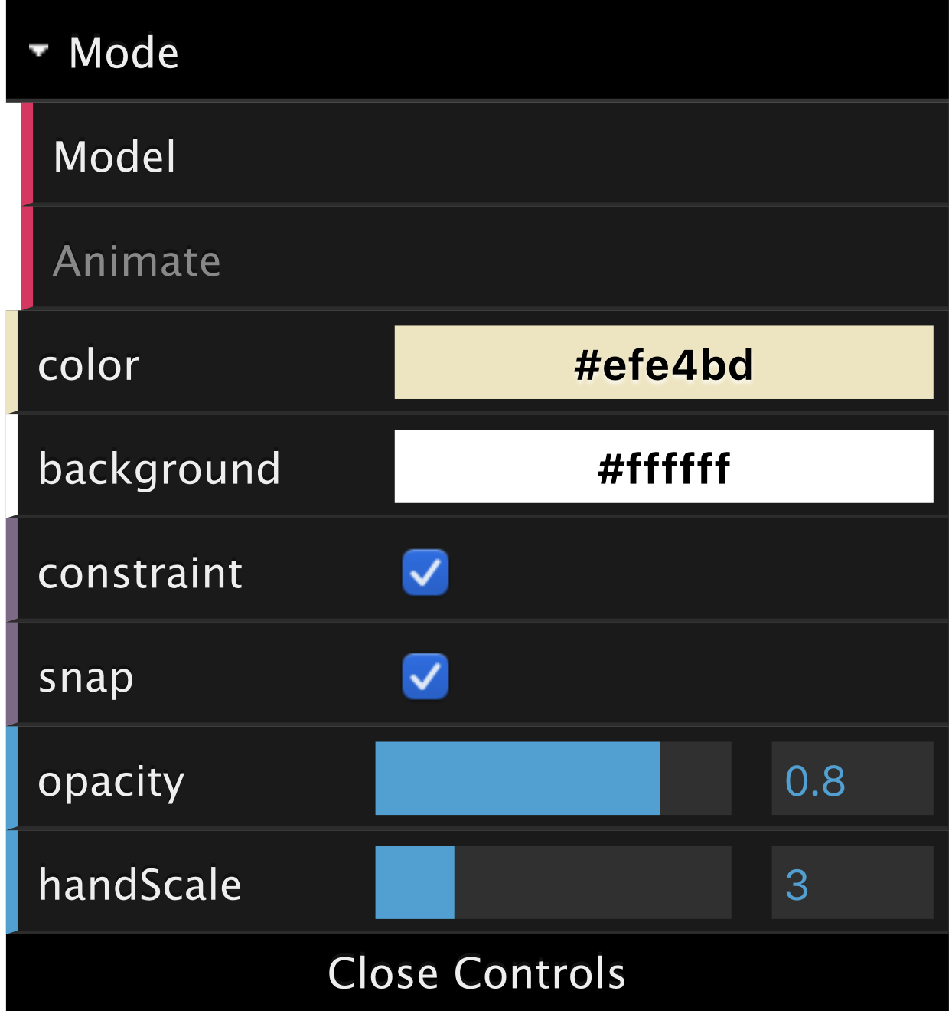
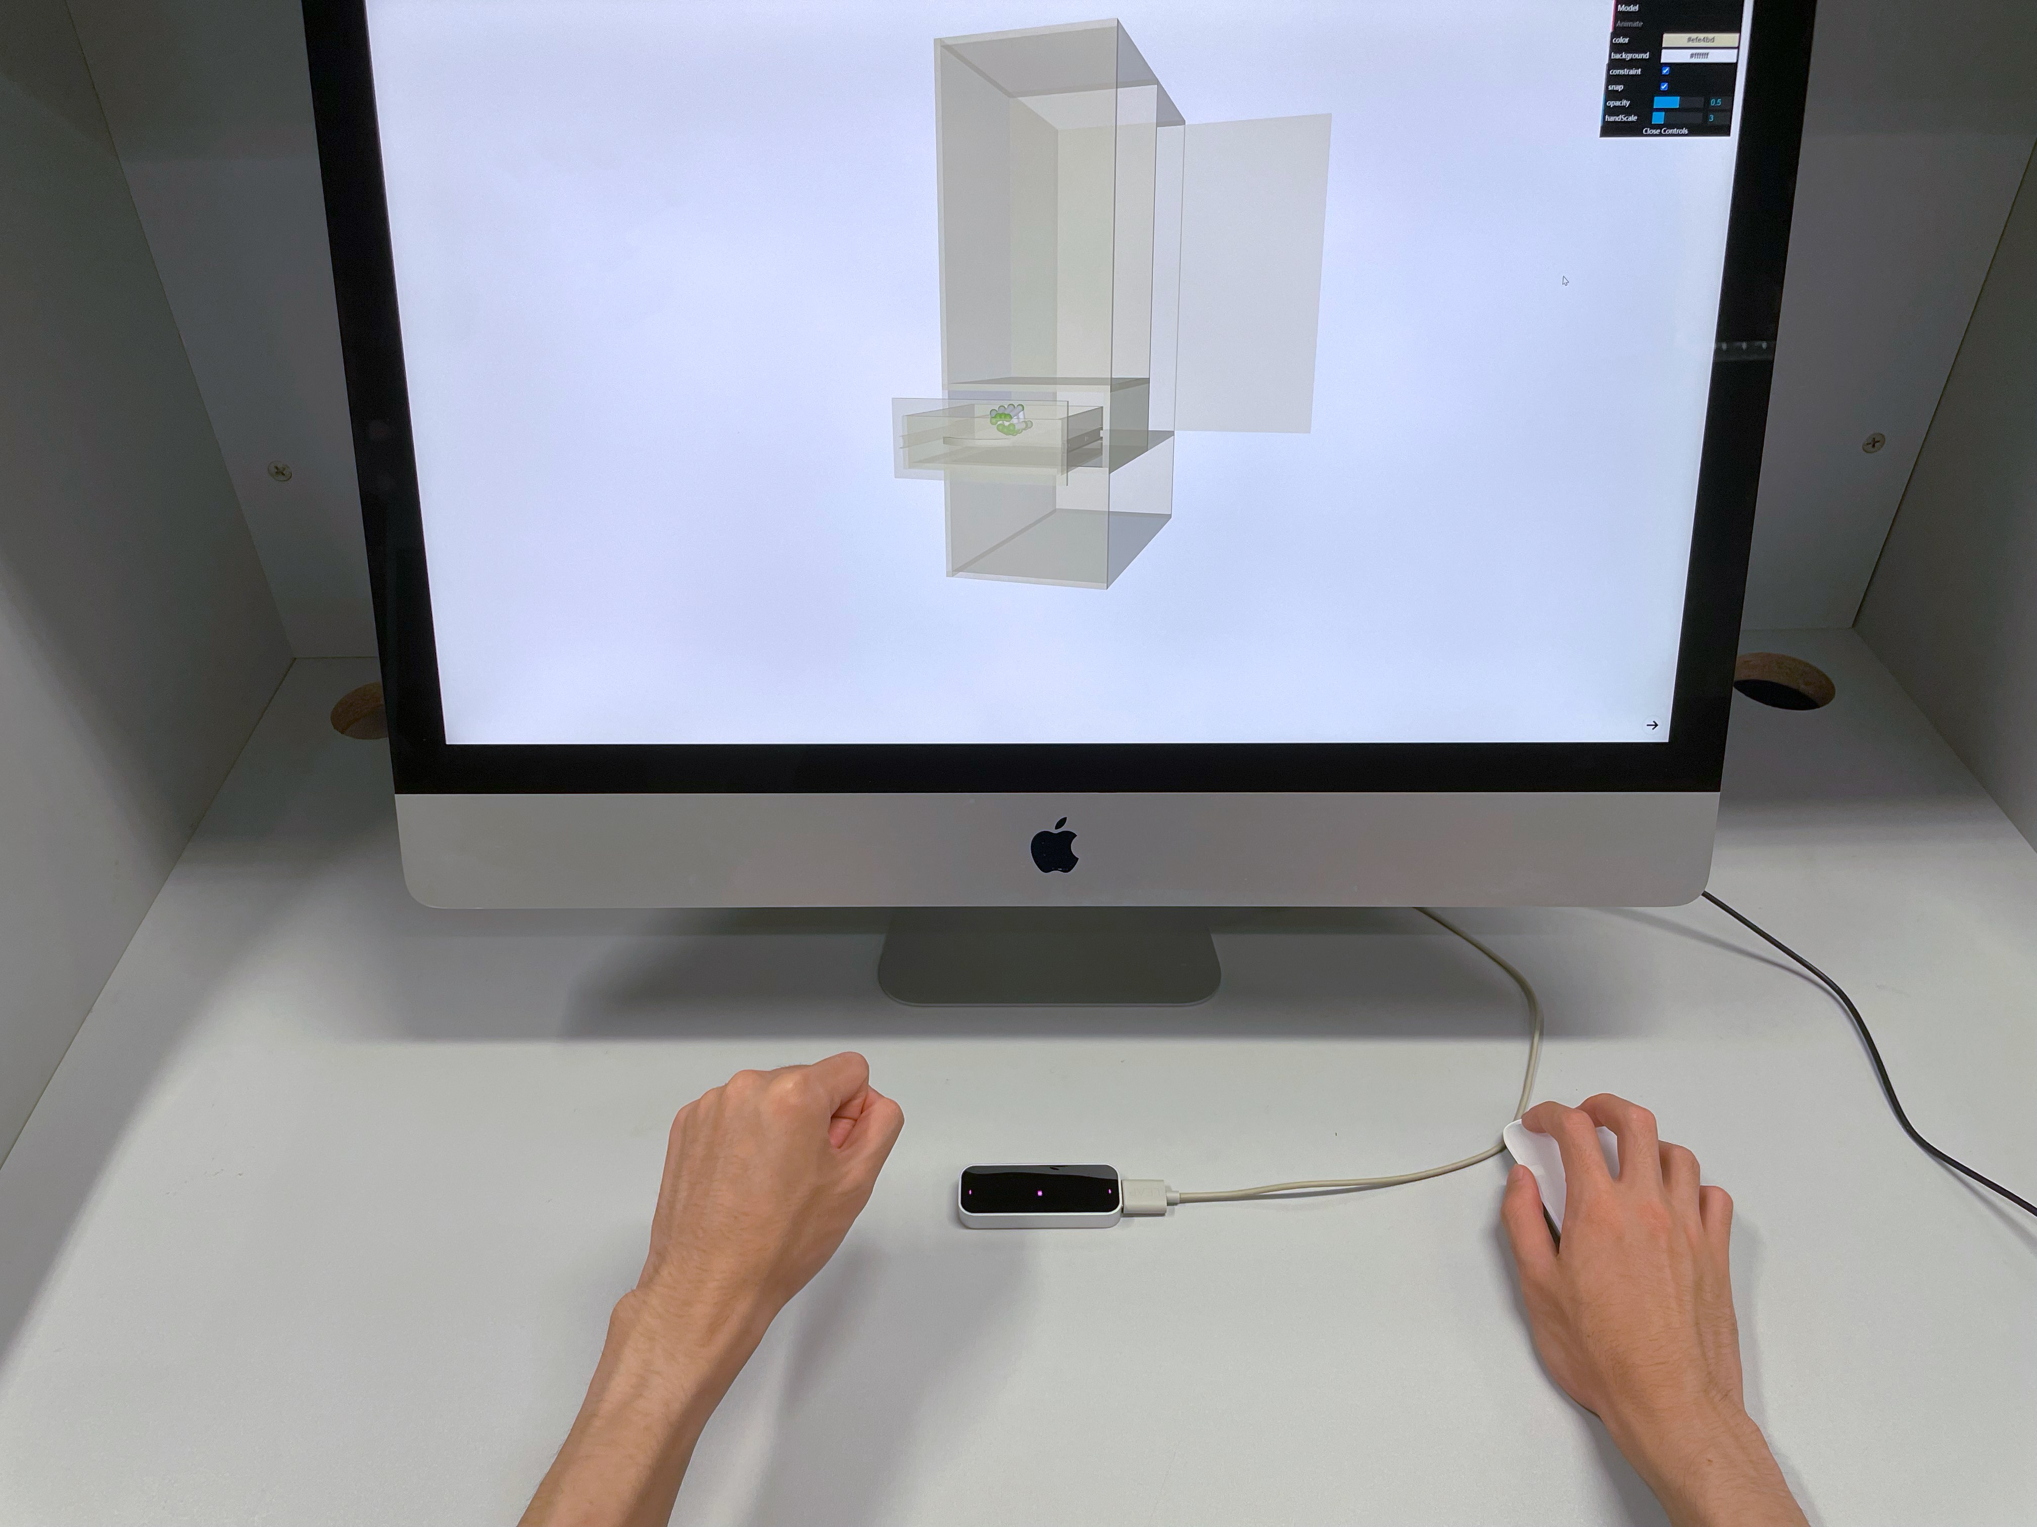
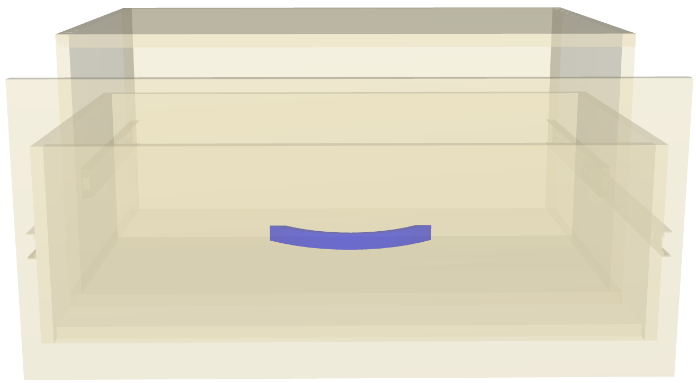
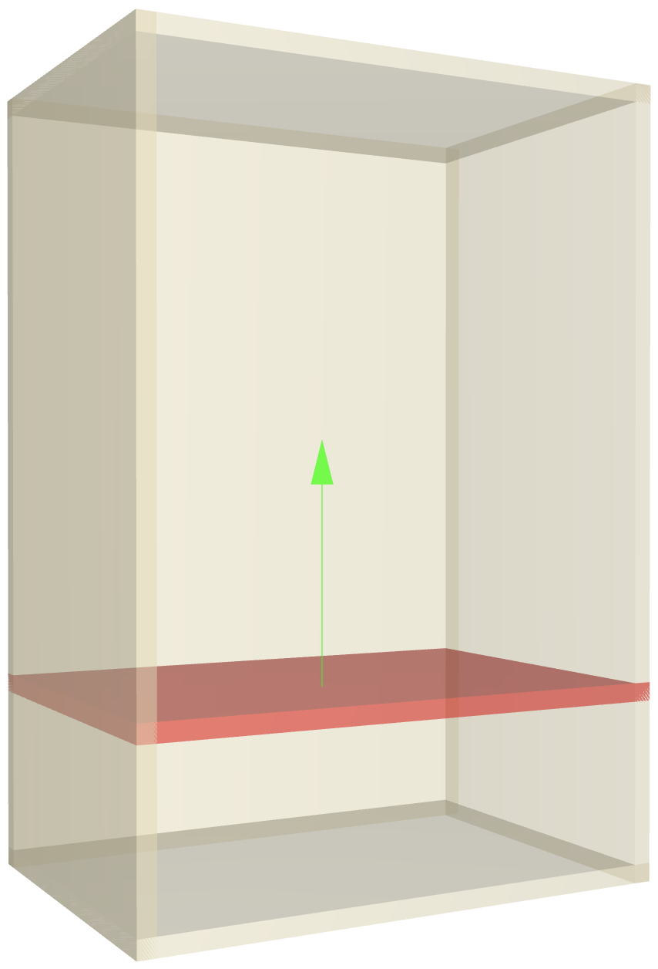
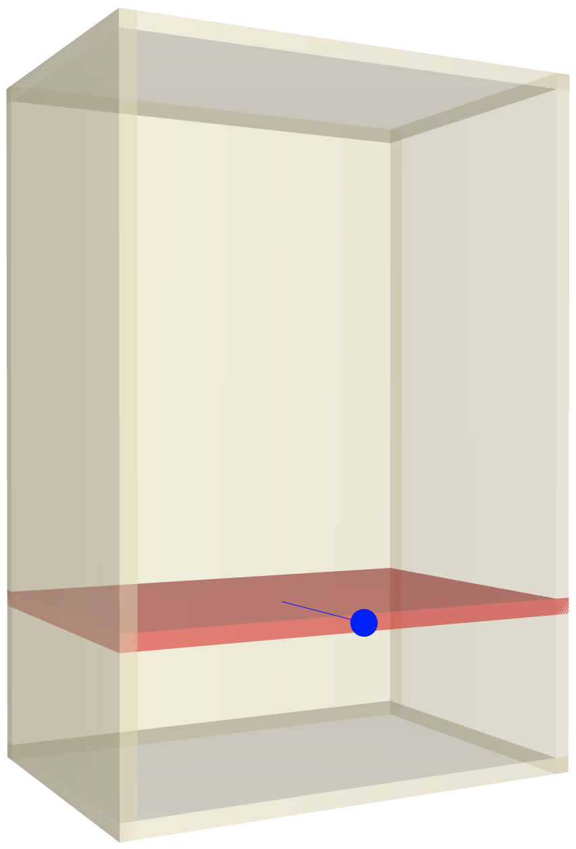
User Interface
Notes:
With the chosen motions of the preliminary user study, we built our interface.
(click) In our system, the users do modeling by performing hand motions on top of a Leap Motion Controller, while they can visualize the virtual results on a PC screen
(click) On the left side of the screen, there is a panel with shapes or components for the users to choose from. It will be hidden automatically if the choosing is finished.
(click) On the right side of the screen, there is a panel with basic options users may need
(click) Besides, to keep the feasibility of our created models, only reasonable translating and scaling directions are shown and allowed.

Slide 17
Implementation: Gesture/Motion Recognition
Three poses
All five fingers are extended.
All five fingers are not extended.
The index finger is extended while the others are not.
Notes:
To implement the mentioned user interface, first, we need to do motion recognition
(click) From observation of preliminary user study, we found that users were likely to use different motion trajectories with the same natural hand pose to create different components. Therefore, we classify the valid gestures of a single hand roughly into three poses according to their fingers’ extension states

Slide 18
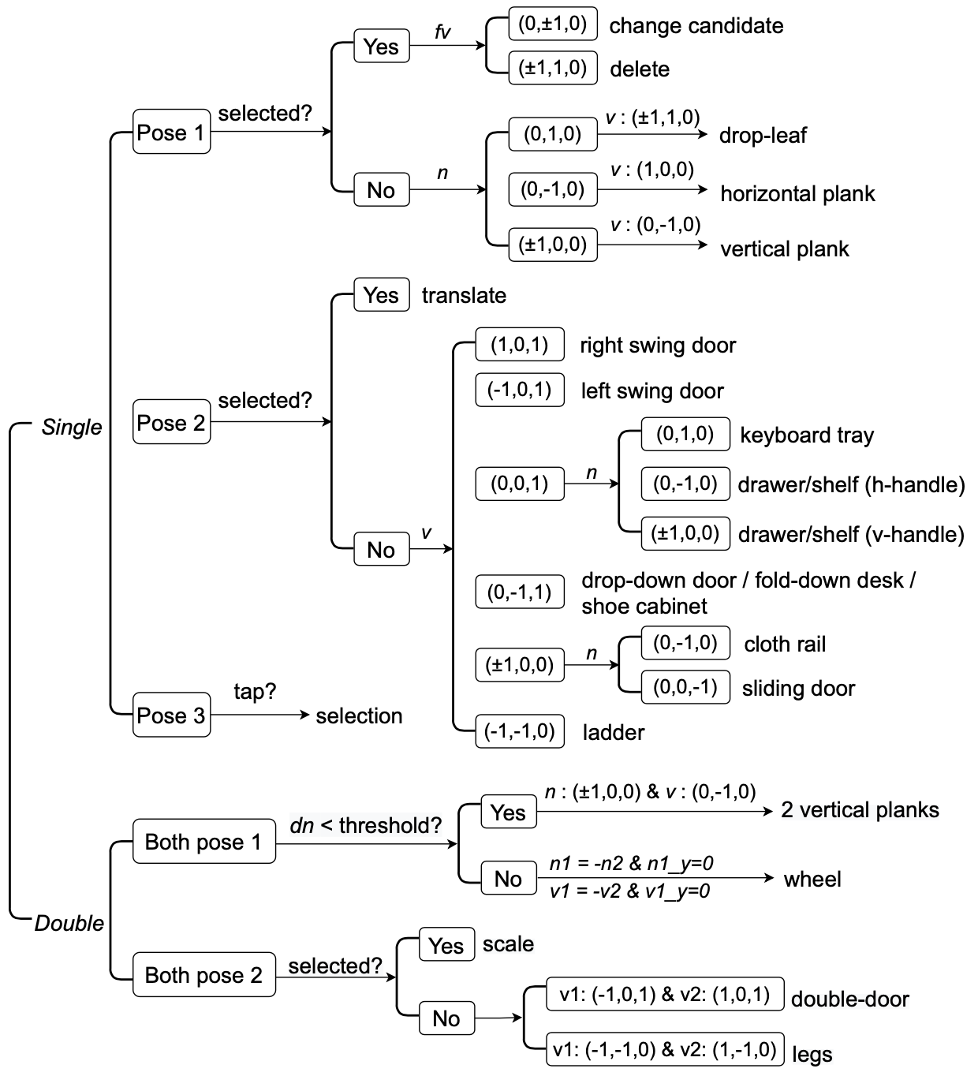
Implementation: Gesture/Motion Recognition
Three poses
Recognize the motion state at each frame by enumeration
Check continuous frames
Notes:
At each frame, we obtained palm normal, hand velocity, finger extension states and finger velocity from leap motion. According to enumerate those data, we can classify the motion into different states.
(click) For every continuous N frames, if some state repeats over m times, the motion will be recognized and its corresponding task will be conducted.

Slide 19
Implementation: Furniture Components
Composed of basic geometric primitives
Notes:
We also prepared 3D furniture components for users to create.
(click) All the furniture components were predefined with the combination of the basic geometric primitives and some built-in widgets.

Slide 20
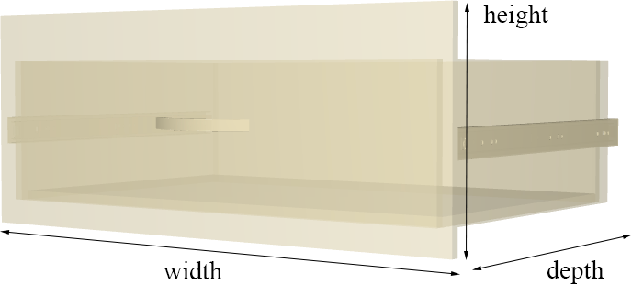
Implementation: Furniture Components
Composed of basic geometric primitives
Pre-set structural arrangement
Notes:
The overall size of each component dependeds on its parameters such as width, height and depth, and the structural arrangement for its sub-components (for example, the relative position and orientation of the basic primitives) are predefined.

Slide 21
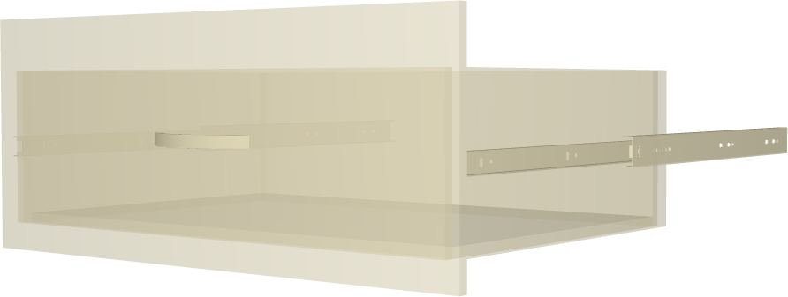
Implementation: Furniture Components
Composed of basic geometric primitives
Pre-set structural arrangement
Additional parameters for animation
translation direction and distance
Notes:
Besides, additional parameters for dynamic component such as translation direction and distance, or rotation axis and angle are also predefined.

Slide 22
Implementation: Auto-Composition
A binary tree structure to store the spatial information.
A leaf node
Notes:
Our system automatically fits the new furniture component to the current 3D model according to the user’s hand position.
(click) To achieve this, we use a binary tree structure to store the spatial information of the model. The leaf nodes of this binary tree are the spare space that can be further assigned components

Slide 23
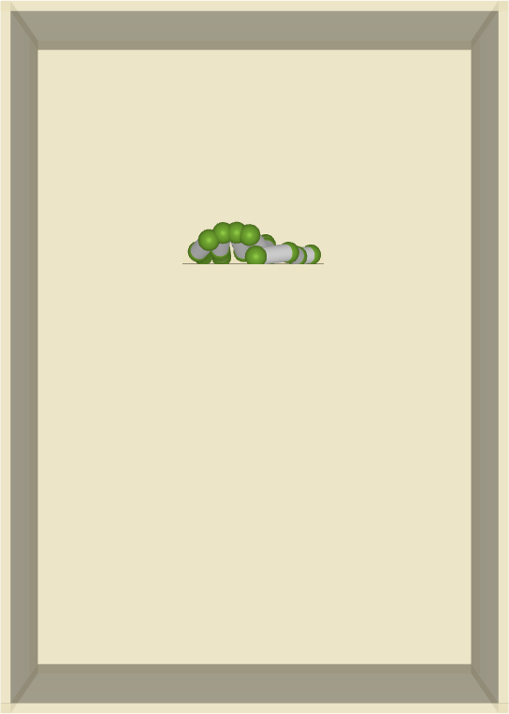
Implementation: Auto-Composition
A binary tree structure to store the spatial information.
Find the leaf nodes ( ) that contain the hand(s) in the 2D rendered scene.
Notes:
With each recognized hand motion, we find the leaf nodes that contain the hand(s) in the 2D rendered scene. If more than one leaf nodes are found, we choose the one that contains the hand(s) in the 3D scene or the one closest to the camera if no leaf node contains the hand(s) in 3D space.

Slide 24
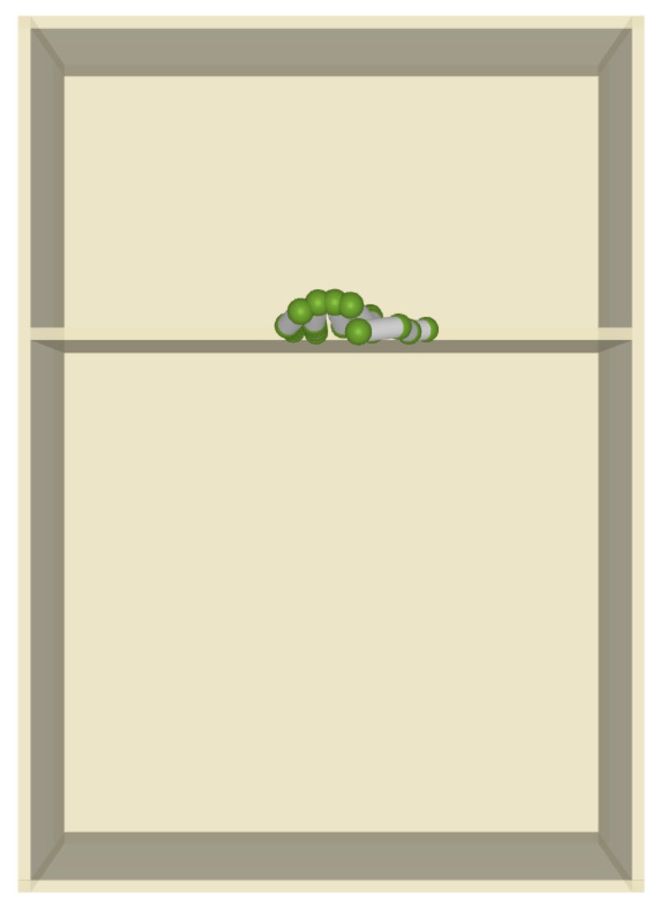
Implementation: Auto-Composition
A binary tree structure to store the spatial information.
Find the leaf nodes ( ) that contain the hand(s) in the 2D rendered scene.
Fit corresponding parameterized primitive into the leaf node.
Notes:
The corresponding predefined parameterized component will be fitted into the leaf node according to the spacial information of leaf node and hands’ position.

Slide 25
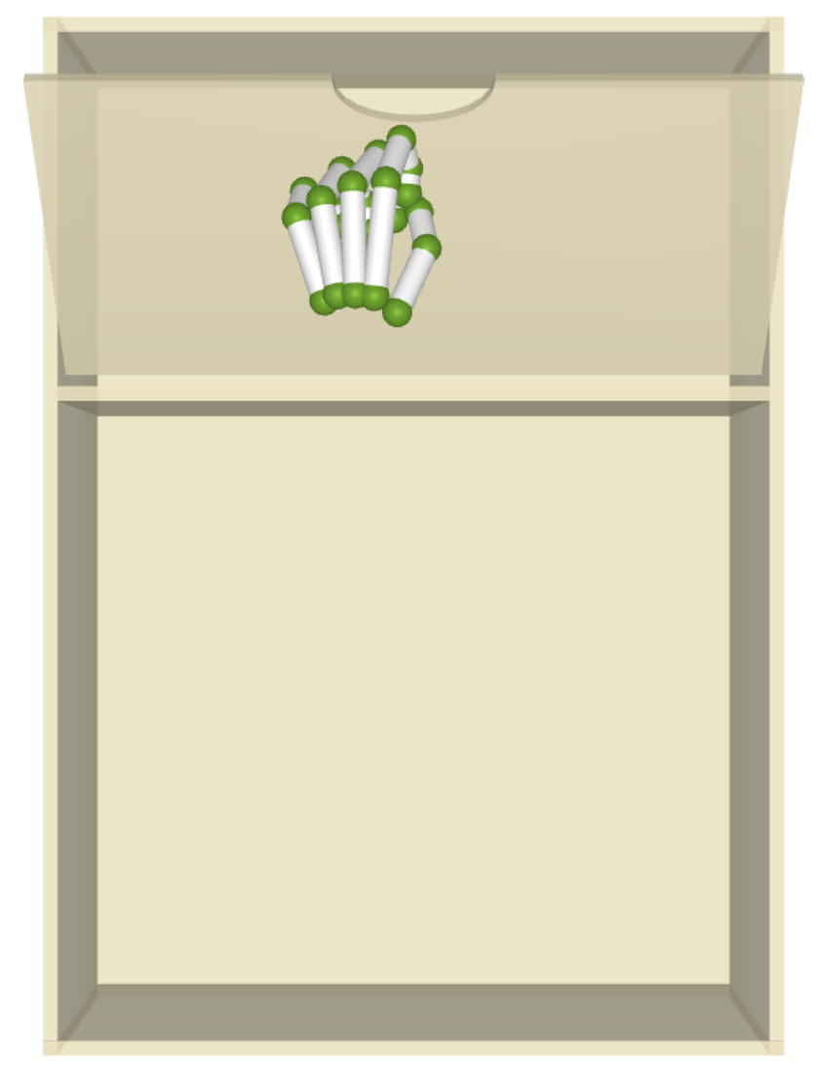
Implementation: Auto-Composition
A binary tree structure to store the spatial information.
Find the leaf nodes ( ) that contain the hand(s) in the 2D rendered scene.
Fit corresponding parameterized primitive into the leaf node.
Update tree structure
Notes:
Then The leaf node will be divided into two leaf nodes,
(click) be deleted or be updated according to the category of the newly added component.

Slide 26
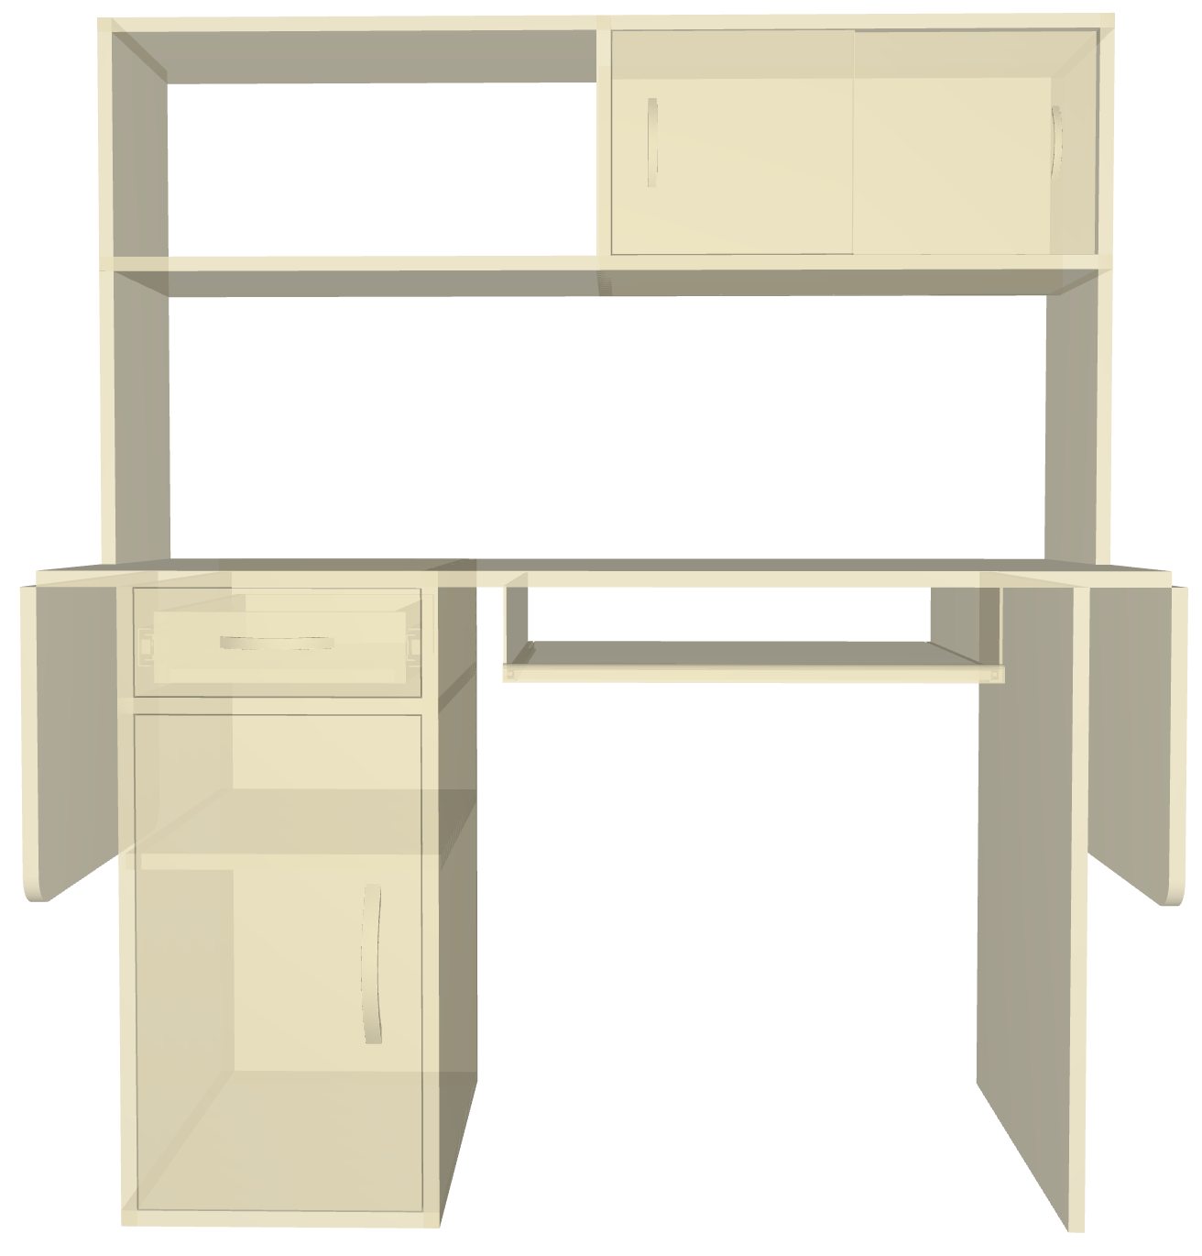
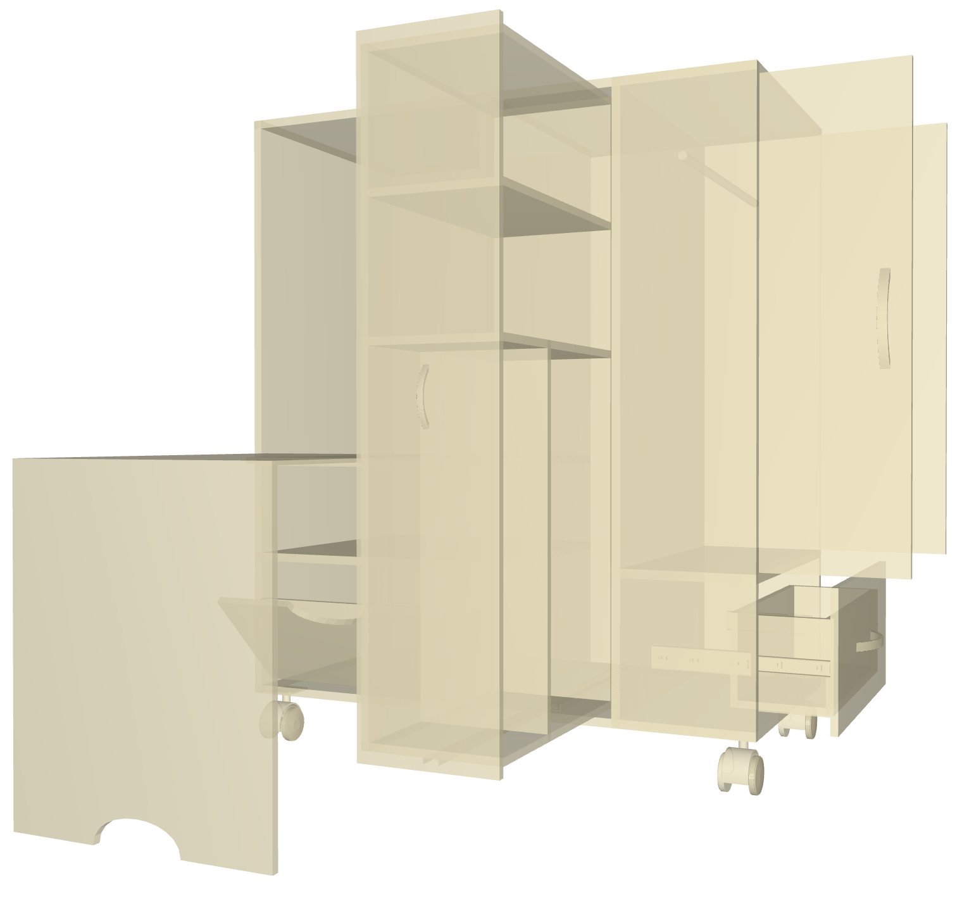
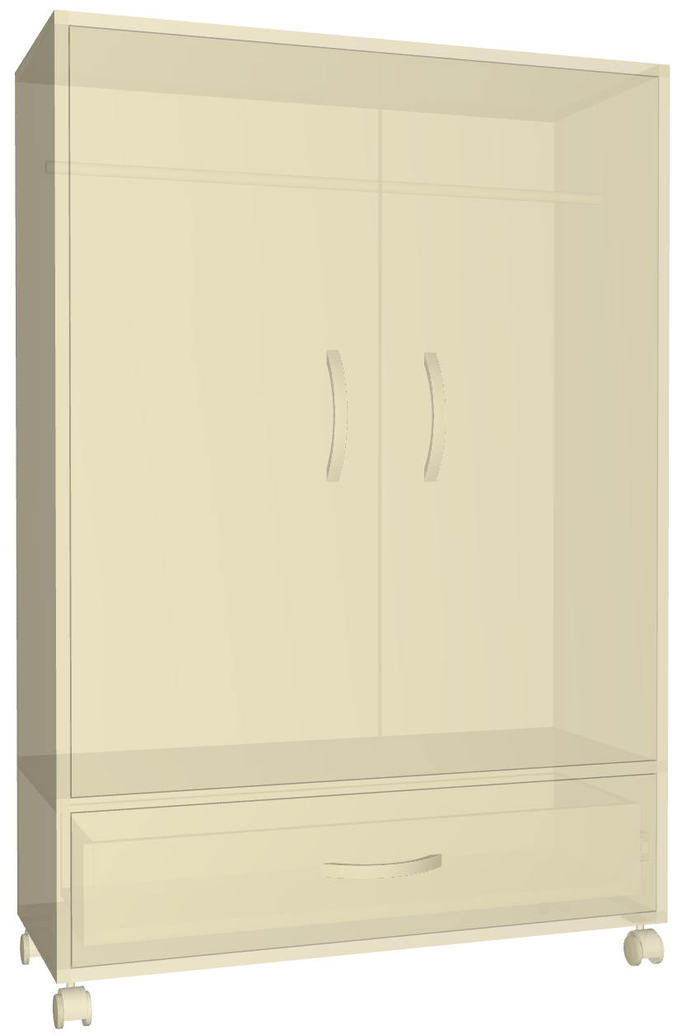
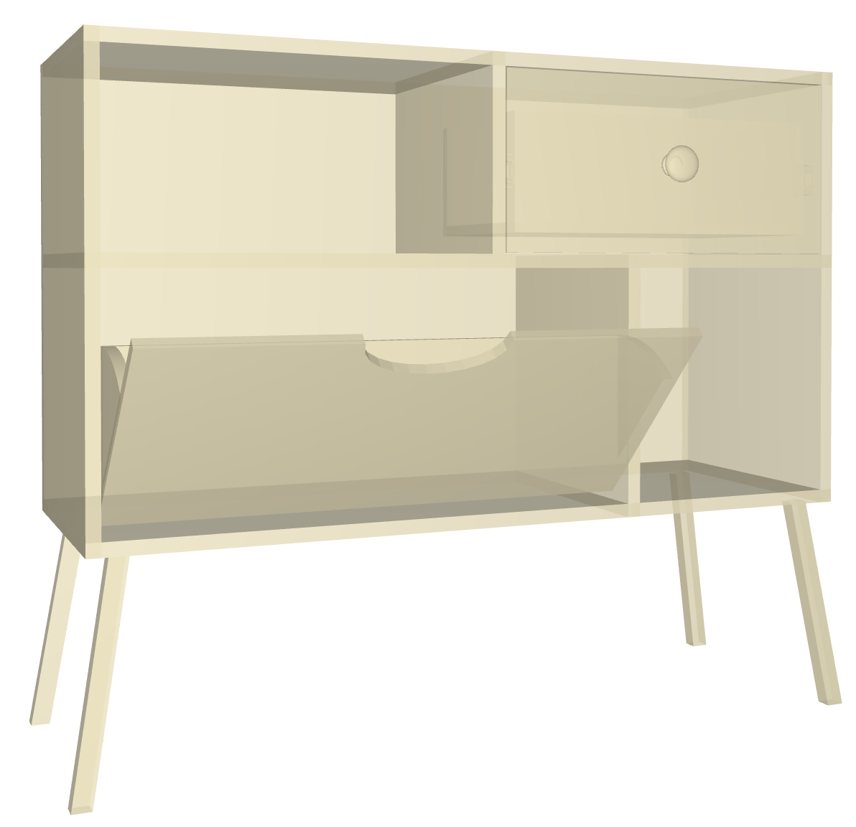
Evaluation User Study
Tutorial
Model reconstruction (2 easy & 2 complex) + design of choice
Questionnaires and semi-structured interview
Notes:
To evaluate the usability, efficiency and intuition of our modeling interface, we invited twelve participants from our university for the evaluation user study.
The user study is composed of 3 parts:
(click) First, we took a 20 minutes tutorial to let users have a basic command of the leap motion controller and our modeling system
(click) (click) Second, we prepared four models for users to rebuild. After reconstructions, users were asked to build one or two model(s) of their choice.
(click) Last, we used questionnaires to let users rate their preference for the motions and attributes of user interface. And then we conducted a semi-structured interview to ask users about their feelings and suggestions for our system.

Slide 27
Evaluation User Study: result
Usability and efficiency
Ave: 1:51 2:48 7:49 7:40
SD: 0:40 1:00 2:02 1:46
Notes:
As a result, all of the users can finish the task of rebuilding the four models, which shows that our system is novice-friendly.
Besides, the average time it took is from 2 minutes to eight minutes, which shows the efficiency of our system.

Slide 28
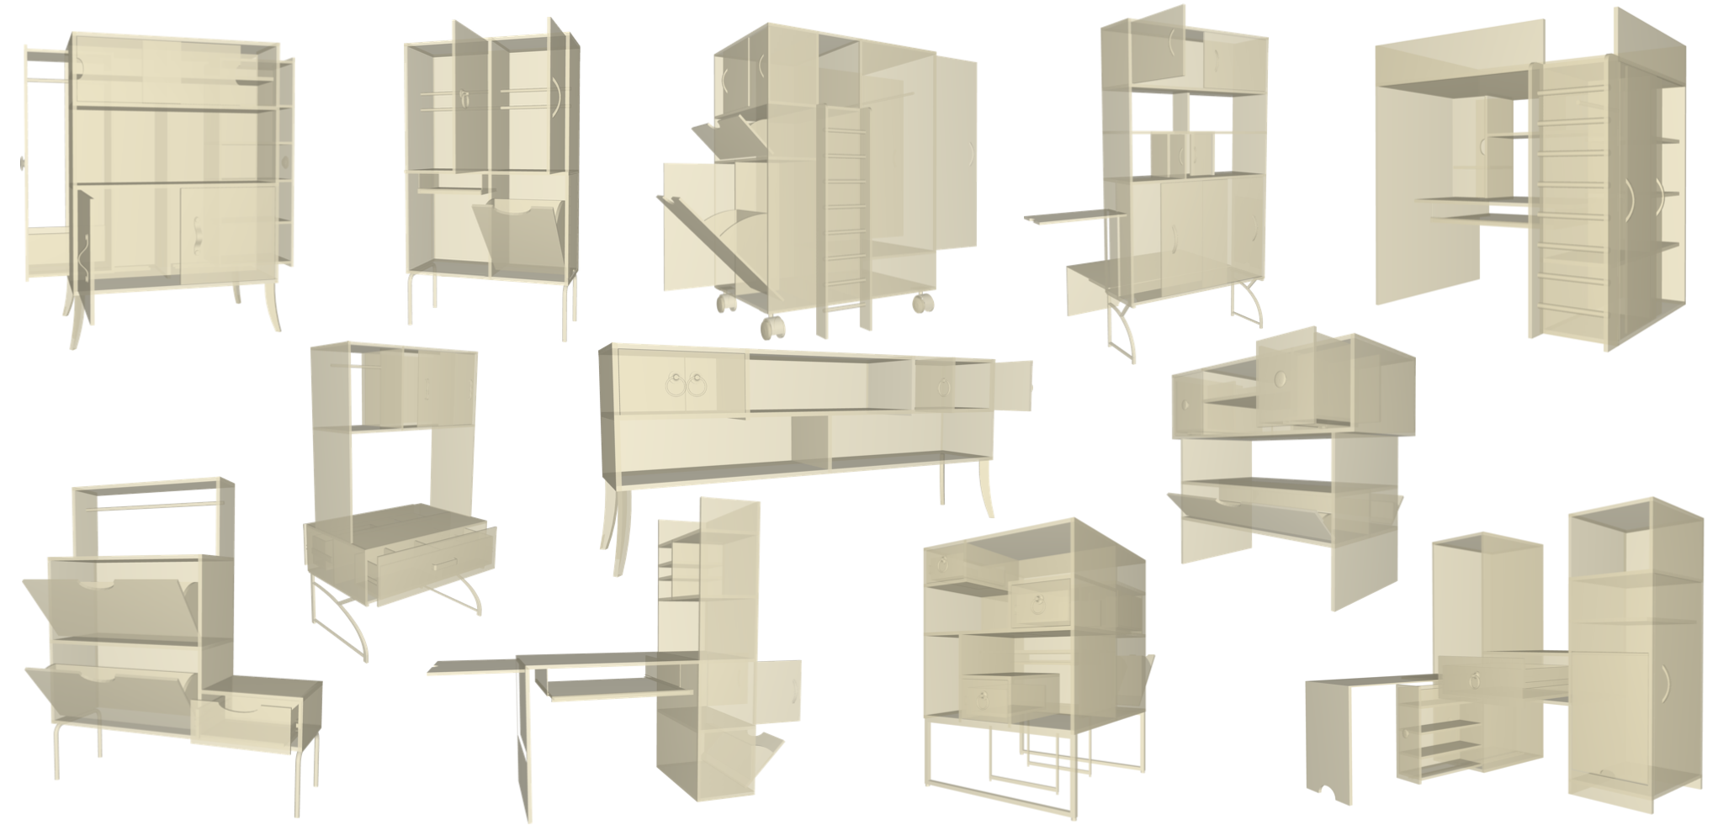
Evaluation User Study: result
Notes:
For the DIY part, users designed various 3D furniture models ranging from a dressing table to a composite-bed with desk and cabinet. It shows that the limitation of components doesn’t constrain the users’ free conceptual design, and personalized furniture structures and functions can be achieved.

Slide 29
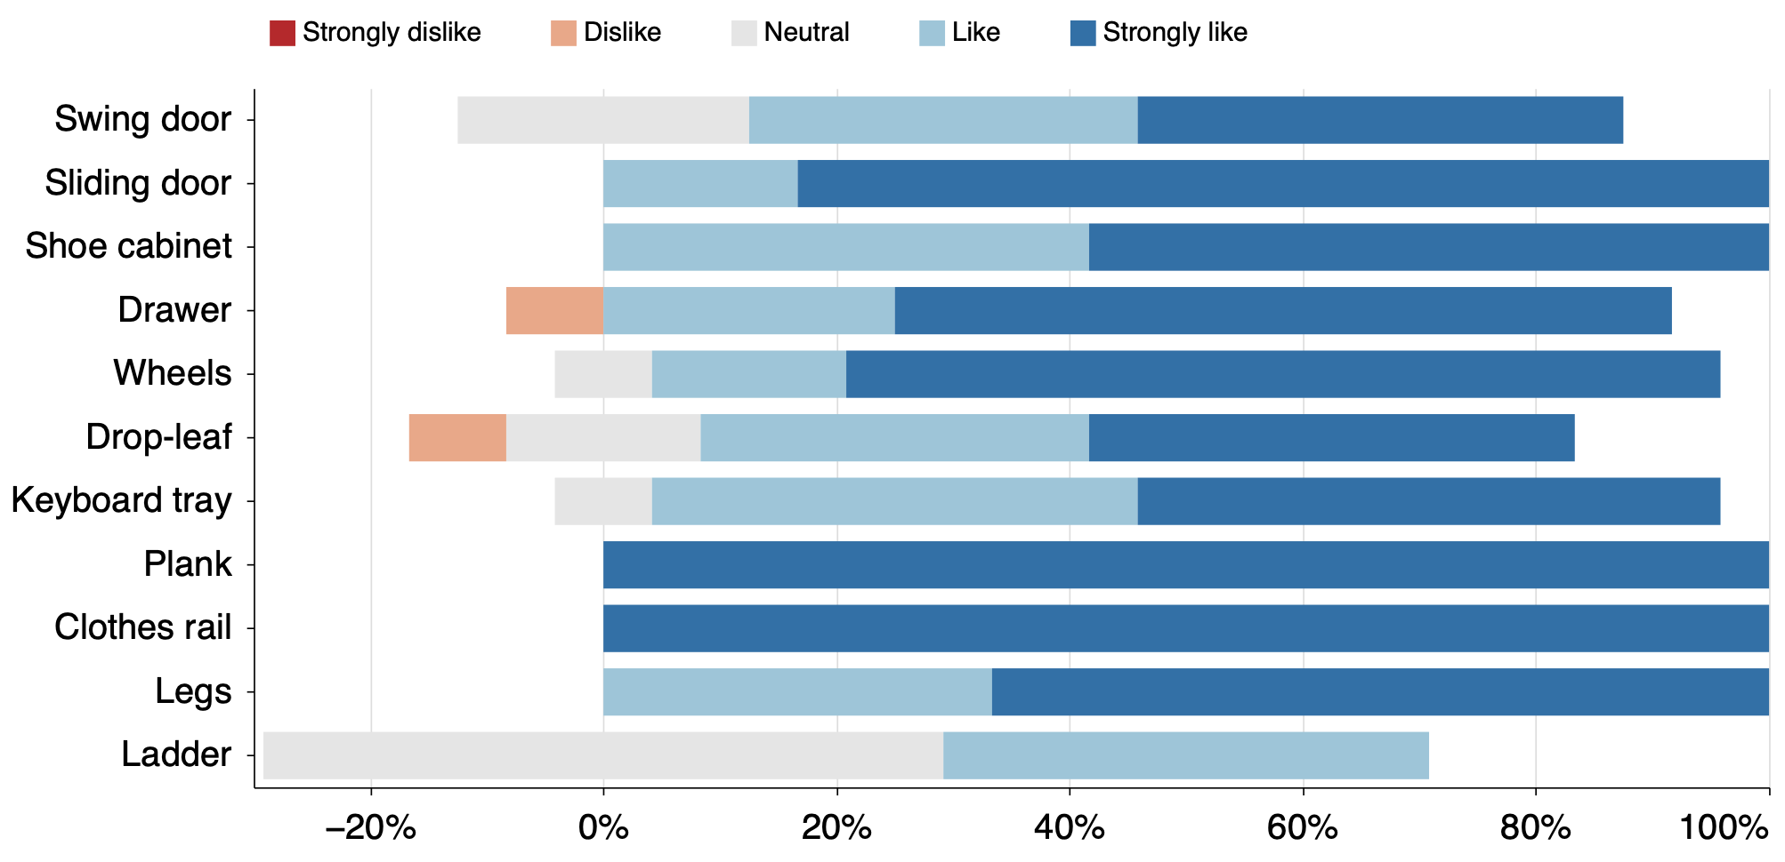
Evaluation User Study: result
Preference for the motions
Notes:
The questionnaires explore user’s preference for each motion. As the picture shows, all the motions for creating components (except for the ladder) are liked by most users. Many users said that they think this kind of interface is cool and fancy.

Slide 30
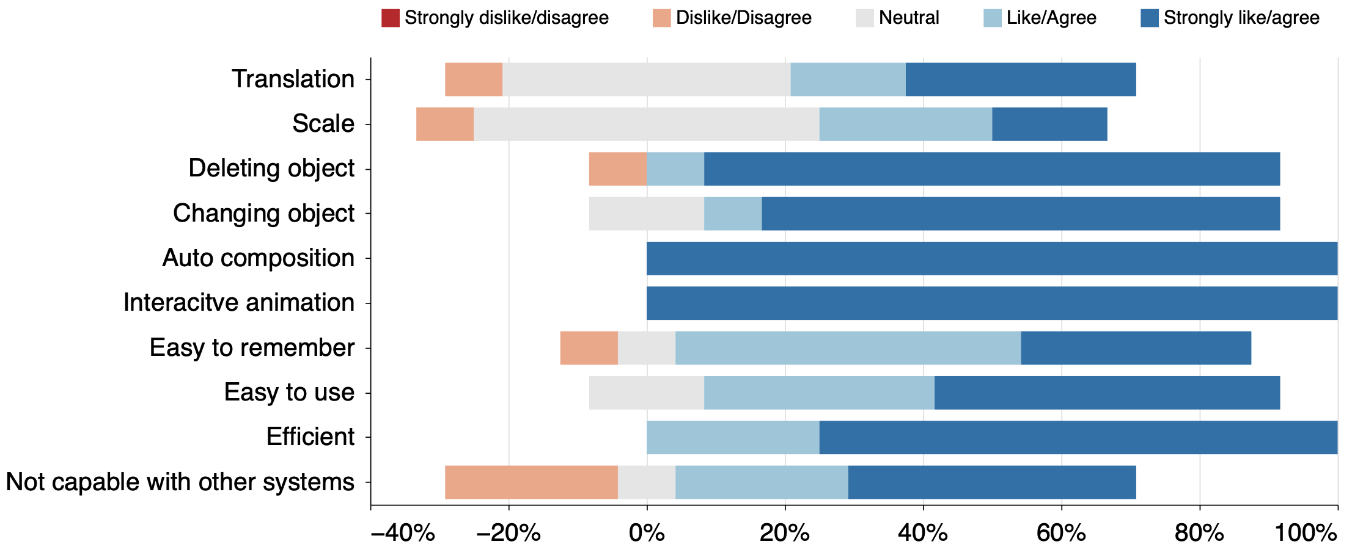
Evaluation User Study: result
Preference for system
Notes:
The questionnaire also shows that all the users like the auto-composition and interactive animation of our system. Most of them agreed that our system is easy and efficient to use, and is easy to remember.

Slide 31
Limitations and Future Work
The modeling results are restricted by the predefined components.
elicitation study for richer components
learning-based motion recognition methods
trade-off between the variety and the user-friendliness
Notes:
While we successfully designed and implemented a “motion-guided” interface, there are some limitations.
(click) First, the modeling results come from the predefined components.
(click) To scale it to a richer set, we could follow the same approach of an elicitation study to find out the users’ corresponding natural motions.
(click) However, as the types and complexity of users’ motions increase, our tree-based recognition logic may be overwhelmed, and learning-based motion recognition methods may work better.
(click) Additionally, the trade-off between the variety of motions and the user-friendliness of the interface can be further explored in future work.

Slide 32
Limitations and Future Work
The modeling results are restricted by the predefined components.
The limitation of hand tracking devices
better hand tracking devices such as MANUS glove
Notes:
Second, the limitation of hand tracking devices can affect our system
In this work, we chose the Leap Motion Controller as our hand tracking device. However, its tracking range is much limited and the tracking ability is unstable if the light is bright or hands have self-occlusion.
(click) For future work, we can improve our system with other and/or better hand tracking devices.

Slide 33
Limitations and Future Work
The modeling results are restricted by the predefined components
The limitation of hand tracking devices
Focus on “hand” motions in a desktop environment and furniture
broader contexts in more immersive environments
Notes:
Third, our work only covers “hand” motions in a desktop environment and designs for modeling furniture,
(click) However, “hand” or “full body” interactions are also highly relevant and intuitive in immersive environments and the “motion-guided” idea should work in more general 3D modeling like interior design or car design.

Slide 34
Limitations and Future Work
The modeling results are restricted by the predefined components.
The limitation of hand tracking devices
Focus on “hand” motions in a desktop environment and furniture
Lack of precision
Notes:
Finally, our user interface is proposed for the conceptual design of furniture, which focuses more on the furniture structures and their dynamic or interactable functions, and our system does not provide precise modeling

Slide 35
Conclusion
Explore the idea of a ``motion-guided'' 3D modeling interface;
Design and implement a 3D modeling system that uses this concept;
Perform an evaluation user study to demonstrate the strengths and weaknesses.
Notes:
In summary,
(click) We explore the idea of a ``motion-guided'' 3D modeling interface, where users naturally perform 3D modeling operations as if interacting with the dynamic parts, and the generated components are interactable
(click) We design and implement a 3D modeling system that uses this concept
(click) We perform an evaluation user study to demonstrate the strengths and weaknesses of our ``motion-guided'' interface.

Slide 36
Thank You !
Notes:
Thanks for your attention!

